Slide 1
JavaScript Part 1

Slide 2

Hello world!
I AM MEMONA HAQ
I am a software engineer at Entelect.
You can contact me at:
memona.haq@entelect.co.za

Slide 3
Recap
<!DOCTYPE html>
<html>
<head>
<title>Page Title</title>
</head>
<body>
<h1>My First Heading</h1>
<p>My first paragraph.</p>
</body>
</html>
HTML
HyperText Markup Language
It is the most basic building block of all websites
Notes:
It is a language for websites, and a browser will understand it. It is for web. Explain what a browser is (just another program loaded on your computer, that gives you an access point to the internet in a understandable way)
Safari, Explorer, Chrome, Firefox

Slide 4
Recap
body {
background-color: lightblue;
}
h1 {
color: white;
text-align: center;
}
p {
font-family: verdana;
font-size: 20px;
}
CSS
Cascading Style Sheets
It describes HOW HTML elements should be displayed

Slide 5
Today – JavaScript Part 1
What is JavaScript?
Where does JavaScript go?
Statements
Syntax
Output
Variables
Let
Const
Operators
Arithmetic
Assignment

Slide 6
1
What is JavaScript?

Slide 7

What is JavaScript?
HTML to define the content of web pages
CSS to specify the layout of web pages
JavaScript to program the behaviour of web pages
Structural
Behavioural
Presentational

Slide 8
What is JavaScript?
Programming language of the Web
Web pages are not the only place where JavaScript is used
Many desktop and server programs use JavaScript. Node.js is the best known
JavaScript is not Java
ECMAScript
Notes:
JavaScript is one of 3 languages for web developers
Web pages are not the only place where JavaScript is used.
Many desktop and server programs use JavaScript. Node.js is the best known.
JavaScript and Java are completely different languages, both in concept and design.
ECMAScript is the official name of the language.

Slide 9
What can JavaScript do?
Change HTML Content
Change HTML Attribute Values
Change HTML Styles (CSS)
Hide/Show HTML Elements

Slide 10
2
Where does JavaScript go?

Slide 11
Where To: The <script> Tag
In HTML, JavaScript code is inserted between <script> and </script> tags.
Works like the <style> tag

Slide 12
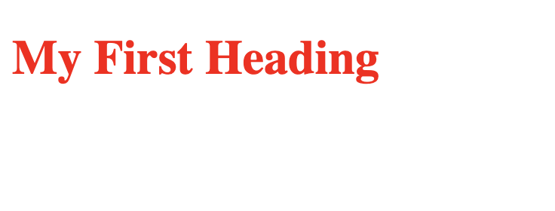
Where To: The <style> tag recap
<!DOCTYPE html>
<html>
<head>
<style>
h1 {
color: red;
}
</style>
</head>
<body>
<h1>My First Heading</h1>
</body>
</html>

Slide 13
Where To: The <script> Tag
<script>
// My JavaScript code
</script>
Notes:
The <script> tag works in a similar way. Instead of allowing you to define styles for your elements, it allows you to interact and add some logic to your elements.
Side note: Comments: // is to provide information and doesn’t get executed or run

Slide 14
Where To: JavaScript in <head> or <body>
Scripts can be placed in either the <head> or the <body> section, or both.
You can add any number of <script> tags in your html
Notes:
Scripts can be placed in the <body>, or in the <head> section of an HTML page, or in both.
You can place any number of scripts in an HTML document.

Slide 15
Where To: Function and Events
function myFunction() {
alert(”I’m an alert triggered by the button");
}
Notes:
Some background knowledge for the next example
A JavaScript function is a block of JavaScript code, that can be executed when "called" for.
For example, a function can be called when an event occurs, like when the user clicks a button.
We’ll go into much more detail about functions in the next sessions.

Slide 16
Where To: JavaScript in <head>
<!DOCTYPE html>
<html>
<head>
<script>
function myFunction() {
alert(”I’m an alert triggered by the button");
}
</script>
</head>
<body>
<h1>A Web Page</h1>
<button type="button" onclick="myFunction()">Try it</button>
</body>
</html>
Notes:
In this example, a JavaScript function is placed in the <head> section of an HTML page.
The function is invoked (called) when a button is clicked:

Slide 17
Where To: JavaScript in <body>
<!DOCTYPE html>
<html>
<body>
<h1>A Web Page</h1>
<button type="button" onclick="myFunction()">Try it</button>
<script>
function myFunction() {
alert(”I’m an alert triggered by the button");
}
</script>
</body>
</html>
Notes:
In this example, a JavaScript function is placed in the <body> section of an HTML page.
The function is invoked (called) when a button is clicked:
There are some problems with placing your script tags in the head
If you have multiple <script> tags in your <head> it will block the HTML from loading.
In other words the user will have to wait for the view to finish loading.
We don’t want the user to wait, that is a bad user experience.
Another problem with placing your <script> tags in your <head>, is that if you have some JavaScript code that selects an element by Id, that element might not be available when the JavaScript code executes.
To prevent this, we will place our <script> tag at the very end of our <body>
Also This is known as internal JavaScript

Slide 18
Where To: External JavaScript
Scripts can also be placed in external files
Reuse the same code in many different web pages
File extension .js
Notes:
Scripts can also be placed in external files:
External scripts are practical when the same code is used in many different web pages.
JavaScript files have the file extension .js.

Slide 19
Where To: External JavaScript
<script src="myScript.js"></script>
Notes:
To use an external script, put the name of the script file in the src (source) attribute of a <script> tag:
Just like the internal script you can place this either in the head or the body
But as we already said
Placing scripts at the bottom of the <body> element improves the display speed, because script interpretation slows down the display.
Also keep in mind that the javascript file should be in the same folder as the html files
There are ways of referencing files that are not in the same folder but we’ll not go into that now

Slide 20
Where To: External JavaScript Advantages
It separates HTML code and JavaScript code
It makes HTML and JavaScript easier to read and maintain
Cached JavaScript files can speed up page loads
Notes:
Placing scripts in external files has some advantages:
Cache = keeping the file on hand in the browser to it doesn’t have to be loaded every time.

Slide 21
Demo
Notes:
Demo 1
Internal JS
External JS
P.S. We’ll go through alerts in more detail in a bit

Slide 22
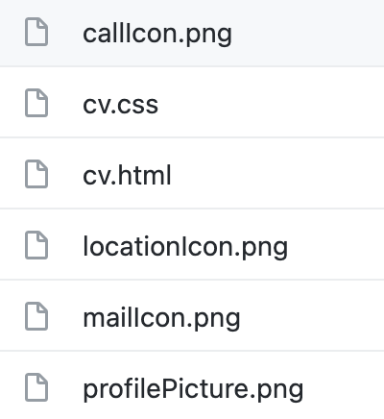
Exercise 1
Go to this link: https://github.com/almarieSaayman/ladiesThatCode/tree/master/CV%20Series/3_CSS/CSS%20Part%202/CV
Download all the files here and store them in the same place.

Slide 23
Exercise 2
Create a JavaScript file: myScript.js
Add your external JavaScript script file to your HTML file (cv.html)
Hint: Use the <script> tag

Slide 24
3
Output

Slide 25
Output
Writing into an HTML element, using innerHTML
Writing into an alert box, using window.alert()
Writing into the browser console, using console.log()
Notes:
JavaScript can "display" data in different ways:
Writing into an HTML element, using innerHTML
Writing into an alert box, using window.alert()
Writing into the browser console, using console.log()

Slide 26
Selectors Recap
class
id
<p class=“firstParagraph”></p>
<p id=“specialParagraph”></p>
.firstParagraph {
/* CSS here */
}
#specialParagraph {
/* CSS here */
}
element
<p></p>
p {
/* CSS here */
}
Notes:
Before we go into more detail about the output types, lets do a quick recap.
Something that was mentioned in the previous html and css sessions was selectors
There are 3 types
Because we defined the class attribute, we select the firstParagraph with a period (.)
Because we defined the id attribute, we select the specialParagraph with a hash (#)
Because we did not define the class or id attribute, we select the paragraph element (<p></p>) by the tag name

Slide 27
Output: Using innerHTML
<p id="test"></p>
document.getElementById("test").innerHTML = “Hello, World!”;
Notes:
Imagine we have this p tag that has the unique id test.
To access this HTML element, JavaScript can use the document.getElementById(id) method.
The id attribute defines the HTML element. The innerHTML property defines the HTML content:
Changing the innerHTML property of an HTML element is a common way to display data in HTML.

Slide 28
Output: Using window.alert()
window.alert(“Hello, World!”);
or
alert(“Hello, World!”);
Notes:
You can use an alert box to display data:
You can skip the window keyword.

Slide 29
Output: Using console.log()
console.log(“Hello, World!”);
Notes:
For debugging purposes, you can call the console.log() method in the browser to display data.
More about debugging in the next sessions

Slide 30
Demo
Notes:
Demo 2
Output
Innerhtml
Alert
Console log

Slide 31
Exercise 3
On the cv.html page; There is a Contact bubble.
When you click on this bubble send an alert that says, “Send me an email.”

Slide 32
Exercise 4
On the cv.html page; There are 3 items in the navigation menu. Home, Resume and Contact.
When you click on any one of them, use console.log to print a message saying
”Navigating to Home”
”Navigating to Resume”
”Navigating to Contact”

Slide 33
Exercise 5
On the cv.html page; There is a <p> tag with the id aboutme.
When you click on the “MY SKILLS” bubble change the innerHTML of the aboutme tag to a list of your skills.

Slide 34
4
Statements

Slide 35
Statements
let x, y, z;
x = 5;
Statements
are
Instructions
y = 6;
z = x + y;
Notes:
1st line declares 3 variables x, y and z. 2nd line assings 5 to x, 6 to y and the addition of x and y to z.
A computer program is a list of "instructions" to be "executed" by a computer.
In a programming language, these programming instructions are called statements.
A JavaScript program is a list of programming statements.
In HTML, JavaScript programs are executed by the web browser

Slide 36
Statements: Composed of
Values
Operators
Expressions
Keywords
Comments
Notes:
JavaScript statements are composed of:
Values, Operators, Expressions, Keywords, and Comments.
We’ll go into more details about each of these

Slide 37
Statements
JavaScript programs are a collection of statements
Executed in sequential order
JavaScript code
Notes:
Most JavaScript programs contain many JavaScript statements.
The statements are executed, one by one, in the same order as they are written.
JavaScript programs (and statements) are often called JavaScript code.

Slide 38
Statements: Semicolons ;
let x, y, z;
x = 5;
y = 6;
z = x + y;
let x, y, z; x = 5; y = 6; z = x + y;
Notes:
Semicolons separate JavaScript statements.
Add a semicolon at the end of each executable statement:
When separated by semicolons, multiple statements are allowed on one line
On the web, you might see examples without semicolons. Ending statements with semicolon is not required, but highly recommended to prevent a lot of issues
PS for me: ; is where the statement ends not line

Slide 39
Statements
let person = "Mimi"; let person="Mimi";
let z = x + y;
document.getElementById("demo").innerHTML = "Hello Dolly!";
Notes:
JavaScript ignores multiple spaces. You can add white space to your script to make it more readable.
The following lines are equivalent:
let person = "Mimi"; let person="Mimi";
A good practice is to put spaces around operators ( = + - * / ): let z = x + y;
For best readability, programmers often like to avoid code lines longer than 80 characters.
If a JavaScript statement does not fit on one line, the best place to break it is after an operator

Slide 40
Statements: Code Blocks
function myFunction()
{
document.getElementById("demo1").innerHTML = "Hello, World!";
document.getElementById("demo2").innerHTML = "How are you?";
}
Notes:
JavaScript statements can be grouped together in code blocks, inside curly brackets {...}.
The purpose of code blocks is to define statements to be executed together.
One place you will find statements grouped together in blocks, is in JavaScript functions:

Slide 41
Statements: Keywords
const
function
let
var
return
for
if
Notes:
JavaScript statements often start with a keyword to identify the JavaScript action to be performed.
Here is a list of some of the keywords you will learn about either in this session or future ones

Slide 42
5
Syntax

Slide 43
Syntax
// How to create variables:
var x;
let y;
// How to use variables:
x = 5;
y = 6;
let z = x + y;
Notes:
JavaScript syntax is the set of rules, how JavaScript programs are constructed:
Syntax rules will be discussed throughout the presentation.

Slide 44
Syntax: Values
Fixed values are Literals
Variable values are Variables
Notes:
The JavaScript syntax defines two types of values:
Fixed values are called Literals.
Variable values are called Variables.

Slide 45
Syntax: Literals
Numbers are written with or without decimals:
10.50 1001
Strings are text, written within double or single quotes:
"John Doe" 'John Doe'
Notes:
The two most important syntax rules for fixed values are:
Numbers are written with or without decimals:
10.50 1001
Strings are text, written within double or single quotes:
"John Doe" 'John Doe'

Slide 46
Syntax
Variables
let x; x = 6;
Operators
(5 + 6) * 10
Keywords
let x;
Expressions
5 * 10
x * 10
"John" + " " + "Doe"
Comments
// I will not be executed
Notes:
Variables are used to store data values.
An equal sign is used to assign values to variables.
JavaScript uses arithmetic operators ( + - * / ) to compute values:
An expression is a combination of values, variables, and operators, which computes to a value.
The computation is called an evaluation.
For example, 5 * 10 evaluates to 50:
Expressions can also contain variable values:
For example, "John" + " " + "Doe", evaluates to "John Doe":
Keywords
JavaScript keywords are used to identify actions to be performed.
The let keyword tells the browser to create variables:
comments
Not all JavaScript statements are "executed".
Code after double slashes // is treated as a comment.
Comments are ignored, and will not be executed:

Slide 47
6
Variables

Slide 48
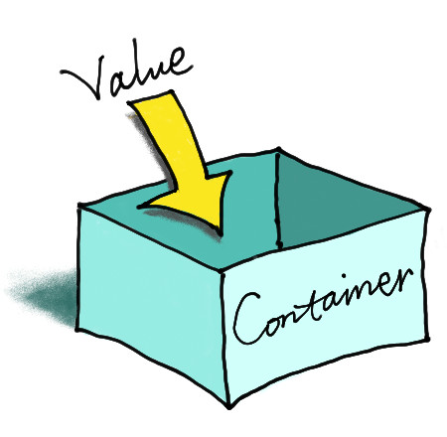
Variables
Notes:
Variables are containers for storing data (values).
There are 3 ways to declare a JavaScript variable:
Using var
Using let
Using const
a

Slide 49
Variables: Declare a JavaScript variable
var
let
const
Notes:
There are 3 ways to declare a JavaScript variable:
Using var
Using let
Using const
Var is not used anymore. Programming languages are ever evolving like any spoken language. Let and const are the preferred methods to declare a variable

Slide 50
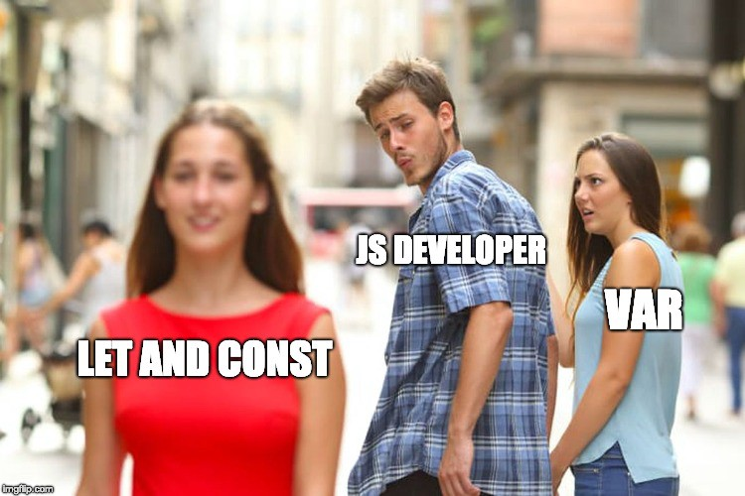
Variables: Declare a JavaScript variable

Slide 51
Variables
var x = 5;
var y = 6;
var z = x + y;
// z stores the value 11
var price1 = 5;
var price2 = 6;
var total = price1 + price2;
// total will be 11
Notes:
In this example, x, y, and z, are variables, declared with the var keyword:
From the example above, you can expect:
x stores the value 5
y stores the value 6
z stores the value 11
Works Like Algebra in mathematics
we use variables (like price1) to hold values.
we use variables in expressions (total = price1 + price2).
From the example above, you can calculate the total to be 11.
JavaScript variables are containers for storing data values.

Slide 52
Variables: Identifiers
Unique names
Identifiers
Short names like x and y
More descriptive names like age, sum, totalVolume
Notes:
All JavaScript variables must be identified with unique names.
These unique names are called identifiers.
Identifiers can be short names (like x and y) or more descriptive names (age, sum, totalVolume).

Slide 53
Variables: Naming rules
Contain letters, digits and underscores
Begin with a letter
Case sensitive (y and Y)
No reserved words
Notes:
The general rules for constructing names for variables (unique identifiers) are:
Names can contain letters, digits, underscores, and dollar signs.
Names must begin with a letter
Names are case sensitive (y and Y are different variables)
Reserved words cannot be used as names

Slide 54
Variables: Declaring (Creating) Variables
”Declaring" means Creating
var carName;
Notes:
Creating a variable in JavaScript is called "declaring" a variable.
You declare a JavaScript variable with the var keyword:
After the declaration, the variable has no value (technically it has the value of undefined).

Slide 55
Variables: One Statement, Many Variables
var person = "John Doe", carName = "Volvo", price = 200;
var person = "John Doe", carName = "Volvo", price = 200;
Notes:
You can declare many variables in one statement.
Start the statement with var and separate the variables by comma:
A declaration can span multiple lines:

Slide 56
Variables: Undefined Values
Declared without a value
Value is calculated or user input
Value will be undefined
Notes:
In computer programs, variables are often declared without a value. The value can be something that has to be calculated, or something that will be provided later, like user input.
A variable declared without a value will have the value undefined.

Slide 57
Variables: Re-Declaring Variables
var carName = "Volvo"; var carName;
Notes:
If you re-declare a JavaScript variable, it will not lose its value.
The variable carName will still have the value "Volvo" after the execution of these statements:

Slide 58
7
Let

Slide 59
Let
Cannot be Redeclared
Must be Declared before use
Have Block Scope
Notes:
DemoVariables defined with let cannot be Redeclared.
Variables defined with let must be Declared before use.
Variables defined with let have Block Scope.

Slide 60
Let: Cannot be Redeclared
let x = "John Doe"; let x = 0;
var x = "John Doe"; var x = 0;
Notes:
Variables defined with let cannot be redeclared.
You cannot accidentally redeclare a variable.
With let you can not do this:
With var you can:

Slide 61
Let: Block Scope
{ let x = 2; }
// x can NOT be used here
{ var x = 2; }
// x CAN be used here
Notes:
let and const provide Block Scope in JavaScript.
Variables declared inside a { } block cannot be accessed from outside the block:
Variables declared with the var keyword can NOT have block scope.
Variables declared inside a { } block can be accessed from outside the block.

Slide 62
Let: Redeclaring Variables
var x = 10; // Here x is 10 { var x = 2; // Here x is 2 } // Here x is 2
let x = 10; // Here x is 10 { let x = 2; // Here x is 2 } // Here x is 10
Notes:
Redeclaring a variable using the var keyword can impose problems.
Redeclaring a variable inside a block will also redeclare the variable outside the block:
Redeclaring a variable using the let keyword can solve this problem.
Redeclaring a variable inside a block will not redeclare the variable outside the block:

Slide 63
8
Const

Slide 64
Const
cannot be Redeclared
cannot be Reassigned
have Block Scope
Notes:
Variables defined with const cannot be Redeclared.
Variables defined with const cannot be Reassigned.
Variables defined with const have Block Scope.

Slide 65
Const
const PI = 3.141592653589793; PI = 3.14; // This will give an error PI = PI + 10; // This will also give an error
Notes:
A const variable cannot be reassigned

Slide 66
Const
const PI;
PI = 3.14159265359;
const PI = 3.14159265359;
Notes:
JavaScript const variables must be assigned a value when they are declared:

Slide 67
Const
Always declare a variables with const
unless the value will change
Notes:
As a general rule, always declare a variables with const unless you know that the value will change.

Slide 68
Demo
Notes:
Demo 3
Var
Let
Const

Slide 69
9
Operators

Slide 70
Operators: Types of operators
Arithmetic Operators
Assignment Operators
String Operators
Comparison Operators
Logical Operators
Type Operators
Bitwise Operators
Notes:
Arithmetic operators are used to perform arithmetic on numbers
Assignment operators assign values to JavaScript variables.
String Operators manipulate string
Comparison and Logical operators are used to test for true or false.
Type Operators check the data type of a JavaScript variable.
Bitwise Operators treat its operands as a set of 32-bit binary digits (zeros and ones) and perform actions

Slide 71
Operators: Types of operators
Arithmetic Operators | + | - | * | ** | / | % | ++ | --
Assignment Operators | = | += | -= | *= | /= | %= | **=
String Operators | + | +=
Comparison Operators | == | === | != | !== | > | < | >= | <= | ?
Logical Operators | && | || | !
Type Operators | typeof | instanceof
Bitwise Operators | & | | | ~ | ^ | << | >> | >>>

Slide 72
Operators: Assignment operator
let x = 5; // assign the value 5 to x
let y = 2; // assign the value 2 to y
Notes:
The assignment operator (=) assigns a value to a variable.

Slide 73
Operators: Addition operator
let x = 5;
let y = 2;
let z = x + y;
// assign the value 7 to z (5 + 2)
Notes:
The addition operator (+) adds numbers.

Slide 74
Operators: String Operators
let firstName = "John"; let lastName = "Doe"; let fullName = text1 + " " + text2;
// assign the value “John Doe” to fullName
Notes:
The + operator can also be used to add (concatenate) strings.
When used on strings, the + operator is called the concatenation operator.

Slide 75
Operators: Adding Strings and Numbers
let x = 5 + 5; // assign the value 10 to x
let y = "5" + 5; // assign the value “55” to x
let z = "Hello" + 5; // assign the value “Hello5” to x
Notes:
Adding two numbers, will return the sum, but adding a number and a string will return a string
If you add a number and a string, the result will be a string!

Slide 76
10
Arithmetic

Slide 77
Arithmetic
Operator | Description
+ | Addition
- | Subtraction
* | Multiplication
** | Exponentiation
/ | Division
% | Modulus (Remainder)
++ | Increment
-- | Decrement
Notes:
Arithmetic operators perform arithmetic on numbers (literals or variables).

Slide 78
Arithmetic: Arithmetic Operations
literals
let x = 100 + 50;
variables
let x = a + b;
expressions
let x = (100 + 50) * a;
Notes:
A typical arithmetic operation operates on two numbers.
The two numbers can be:

Slide 79
Arithmetic: Operators and Operands
Operator
100 + 50
Operand
Operand
Notes:
The numbers (in an arithmetic operation) are called operands.
The operation (to be performed between the two operands) is defined by an operator.

Slide 80
Arithmetic
let x = 5; let y = 2; let z = x + y;
// z = 7
let x = 5; let y = 2; let z = x - y;
// z = 3
let x = 5; let y = 2; let z = x * y;
// z = 10
let x = 5; let y = 2; let z = x / y;
// z = 2.5
let x = 5; let y = 2; let z = x % y;
// z = 1
let x = 5; x--; let z = x;
// z = 4
let x = 5; x++; let z = x;
// z = 6
let x = 5; let z = x ** 2;
// z = 25
Notes:
The addition operator (+) adds numbers
The subtraction operator (-) subtracts numbers
The multiplication operator (*) multiplies numbers
The division operator (/) divides numbers
The modulus operator (%) returns the division remainder.
The increment operator (++) increments numbers.
The decrement operator (--) decrements numbers.
The exponentiation operator (**) raises the first operand to the power of the second operand.

Slide 81
Arithmetic: Operator Precedence
let x = 100 + 50 * 3;
150 * 3 0r 100 + 150
100 + 150
Works like school mathematics!!
Parentheses let y = (100 + 50) * 3;
Same precedence let z = 100 + 50 - 3;
Notes:
Operator precedence is the order in which operations are performed in an arithmetic expression.
Is the result of example above the same as 150 * 3, or is it the same as 100 + 150?
Is the addition or the multiplication done first?
As in traditional school mathematics, the multiplication is done first.
Multiplication (*) and division (/) have higher precedence than addition (+) and subtraction (-).
And (as in school mathematics) the precedence can be changed by using parentheses:
let x = (100 + 50) * 3;
When using parentheses, the operations inside the parentheses are computed first.
When many operations have the same precedence (like addition and subtraction), they are computed from left to right:
let x = 100 + 50 - 3;
Expressions in parentheses are fully computed before the value is used in the rest of the expression.

Slide 82
11
Assignment

Slide 83
Assignment
Operator | Example | Same As
= | x = y | x = y
+= | x += y | x = x + y
-= | x -= y | x = x - y
*= | x *= y | x = x * y
/= | x /= y | x = x / y
%= | x %= y | x = x % y
<<= | x <<= y | x = x << y
>>= | x >>= y | x = x >> y
>>>= | x >>>= y | x = x >>> y
&= | x &= y | x = x & y
^= | x ^= y | x = x ^ y
|= | x |= y | x = x | y
**= | x **= y | x = x ** y
Notes:
Assignment operators assign values to JavaScript variables.

Slide 84
Assignment: Examples
let x = 10;
// x = 10
let x = 10; x += 5;
// x = 15
// x = x + 5
let x = 10; x -= 5;
// x = 5
// x = x - 5
let x = 10; x *= 5;
// x = 50
// x = x * 5
let x = 10; x /= 5;
// x = 2
// x = x / 5
let x = 10;
x %= 5;
// x = 0
// x = x % 5
Notes:
The = assignment operator assigns a value to a variable.
The += assignment operator adds a value to a variable.
The -= assignment operator subtracts a value from a variable.
The *= assignment operator multiplies a variable.
The /= assignment divides a variable.
The %= assignment operator assigns a remainder to a variable.

Slide 85
Demo
Notes:
Demo 4
string
arithmetic
assignment

Slide 86
Thanks!
ANY QUESTIONS?

